Slide 1

Spam Mail Classifier
By
20MCB1005 - Shweta Shewale
20MCB1014 - Diwakar Singh
20MCB1020 - Thanga Purni J S

Slide 2
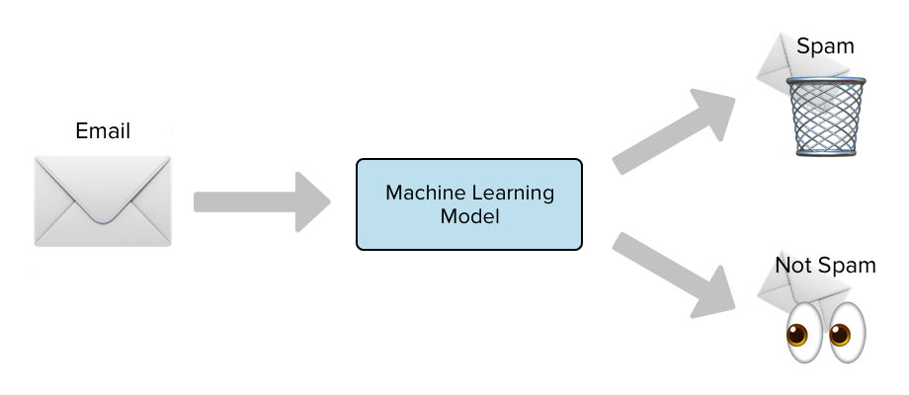
Introduction
In today’s globalized world, email is one of the primary source of communication be it for personal, business, corporate to government. With the rapid increase in email usage, there has also been increase in the SPAM emails. SPAM emails, also known as junk email involves nearly identical messages sent to numerous recipients by email. Apart from being annoying, spam emails can also pose a security threat and time wasting. In this project, we use text mining to perform classification of spam and ham.

Slide 3
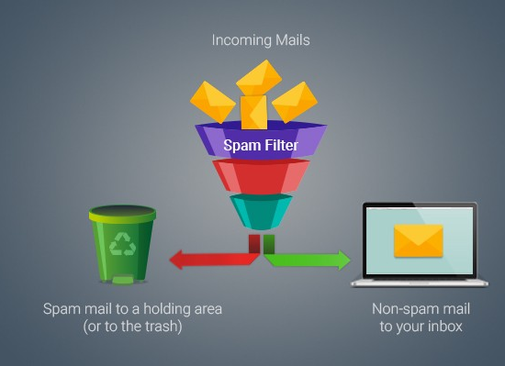
Proposed work
We are using Natural Language Processing and Machine Learning classification algorithms to perform SPAM Mail Classification.
The objective of Spam Email classification project is to build Model using NLTK and ML algorithm for testing the accuracy of identifying SPAM and HAM mails.

Slide 4
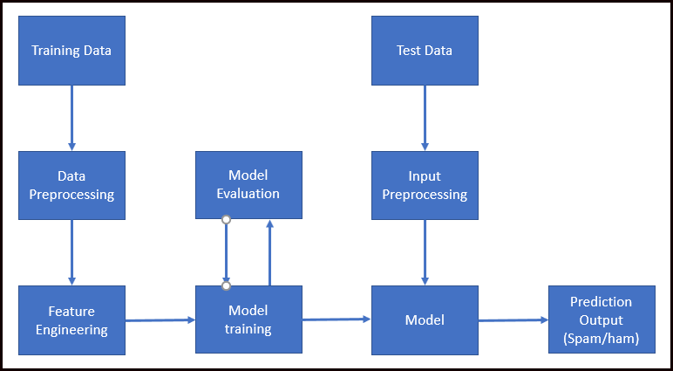
Architecture:
Fig

Slide 5
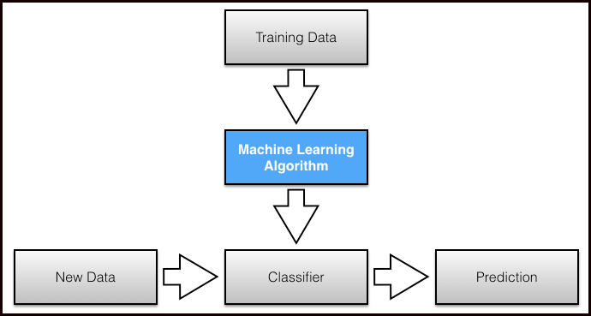

Slide 6
Work Flow:

Slide 7
DATA COLLECTION
DATA PRE-PROCESSING
FEATURE SELECTION
Naïve Bayes
FEATURE EXTRACTION
Logistic Regression
TRAINING AND TESTING DATASET
Decision Tree Classifier
CLASSIFICATION ALGORITHM
SVM
Random Forest Classifier
MODEL ANALYSIS

Slide 8
What are we Planning to Use:-
PROGRAMMING LANGUAGE : Python,JSON.
Libraries: Numpy, Pandas, Seaborn, Matplotlib, NLTK
DATABASE: MongoDB
PLATFORM : Jupyter Notebook

Slide 9
Data Pre-processing:
Pre-processing is a very crucial step in text mining. There are three steps involved in pre-processing viz. tokenization, stop word removal and stemming. The initial step consist of the process called tokenization. In this process all the unnecessary word, punctuations and symbols would be removed from the sentences. Now the strings that are left would be split up into various tokens. The next step is stop word removal. Stopwords are the words which carry nearly no information when considered form the text mining point of view. These words contain pronouns, prepositions and conjunctions like he, she, they, and, if, but, etc. In the second step all such words which carry no information are removed. English language has around 300-400 stop words. A list of these words could be made quite easily and referring to that list they can be removed form the sentences, which in turn would save a lot of space required to store them as well as would reduce the operational time to a great extent

Slide 10
Feature Selection:
In this process we analyze the data (emails in our case) minutely to find out the features(i.e. words) which would be most useful in the classification. Then these features would be further used to train the classifier. For this purpose, we will be using the method known as Term Frequency(TF). TF can be defined as a numerical statistic which is intended to reflect how crucial a word is to a document present in a corpus. The TF value is directly proportional to the number of times a word appears in a document.

Slide 11

Algorithms
Naïve Bayes classifier: Naive Bayes is based on Bayes’ Theorem Formula with an assumption of independence among predictors. Given a Hypothesis A and evidence B, Bayes’ Theorem calculator states that the relationship between the probability of Hypothesis before getting the evidence P(A) and the probability of the hypothesis after getting the evidence P(A|B) is
Naive Bayes work on dependent events and the probability of an event occurring in the future that can be detected from the previous occurring of the same event . This technique can be used to classify spam e-mails, words probabilities play the main rule here. If some words occur often in spam but not in ham, then this incoming e-mail is probably spam. Naive Bayes classifier technique has become a very popular method in mail filtering Email. Every word has certain probability of occurring in spam or ham email in its database. If the total of words probabilities exceeds a certain limit, the filter will mark the e-mail to either category. Here, only two categories are necessary: spam or ham

Slide 12
Decision tree Classifier : Decision trees are used for classification and regression. In decision analysis, a decision tree can be used to visually and explicitly represent decisions and decision making. The decision of making strategic splits heavily affects a tree’s accuracy. The decision criteria is different for classification and regression trees. Information theory is a measure to define this degree of disorganization in a system known as Entropy. If the sample is completely homogeneous, then the entropy is zero and if the sample is an equally divided (50% – 50%), it has entropy of one. It chooses the split which has lowest entropy compared to parent node and other splits. The lesser the entropy, the better it is.

Slide 13
Random forest: Random forest tries to build multiple CART model with different sample and different initial variables. For instance, it will take a random sample of 100 observation and 5 randomly chosen initial variables to build a CART model. It will repeat the process (say) 10 times and then make a final prediction on each observation. Final prediction is a function of each prediction.
Logistic Regression : Logistic Regression is an algorithm for classification. In this algorithm, the probabilities detailing the outcome of our field of interest are modeled using a logistic function which is the basic equation in logistic regression. The outcome of logistic regression is a simple binary result ‘1’ or ‘0’ signifying if an email is a spam or not.

Slide 14
Support Vector Machine (SVM): In this algorithm, we plot each data item as a point in n-dimensional space with the value of each feature being the value of a particular coordinate. Then, we perform classification by finding the hyperplane that differentiate the two classes very well. Support Vectors are simply the coordinates of individual observation. Support Vector Machine is a frontier which best segregates the two classes (hyper-plane/ line). If the data requires non-linear classification, SVM can employe Kernels, which are functions which takes low dimensional input space and transform it to a higher dimensional space i.e. they convert non separable problem to separable problem.

Slide 15
Dataset details
Dataset consist of Rows 5574 and 3 column
Labels: it tell weather email is SPAM or HAM
SMS: it shows the text sentence of data

Slide 16
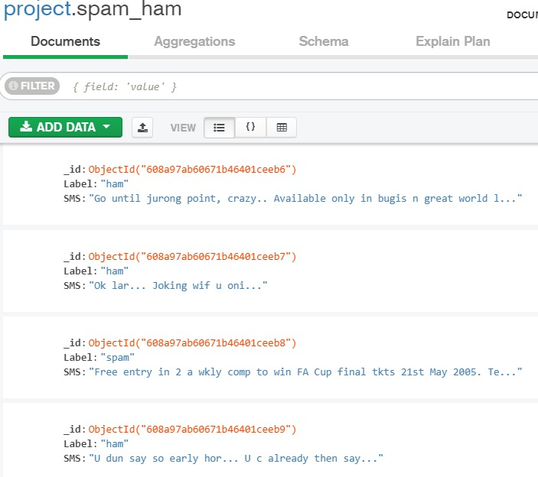

Slide 17
Comparative results
Models | Accuracy
Naive Bayes | 0.9665271966527197
Logistic Regression | 0.9898726838015541
Support Vector Machine | 0.982068141063957
Decision Tree | 0.9527794381350867
Random Forest | 0.9707112970711297

Slide 18
Challenges
After the Connection with Mongodb making the dataset suitable for preprocessing
Visualization on Text data

Slide 19
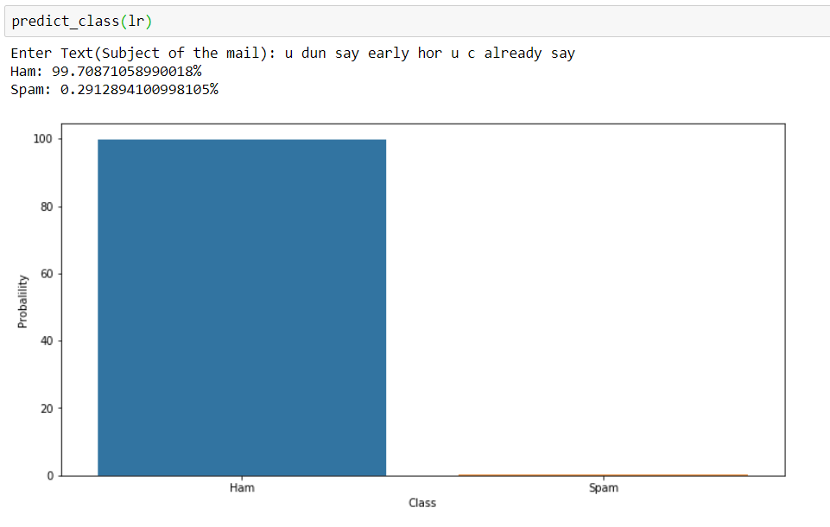
Outcome

Slide 20
Conclusion
Finally we are Classifying the given mail text as Ham or Spam by using the Logistic regression

Slide 21
References
1. E. G. Dada and S. B. Joseph Department of Computer Engineering, University of Maiduguri, Maiduguri – Borno State, Nigeria.et al ., Random Forests Machine Learning Technique for Email Spam Filtering, University of Maiduguri Faculty of Engineering Seminar Series Volume 9 number 1, July 2018 .
2. Divesh Palival, Kevin Printer, Ramchandra Devre, Asst.Prof. Nikita Lemos et al ,. Email Spam Filtering Using Decision Tree Algorithm, International Journal of Scientific & Engineering Research ISSN 2229-5518 Volume 9, Issue 3, March-2018 .
3. Mansi Goyal, Ankita Sharma CSE& Kurukshetra University Haryana, India et al ,. An Efficient Malicious Email Detection Using Multi Naive Bayes Classifier, International Journal of Advanced Research in Computer Science and Software Engineering, Volume 5, Issue 5, May 2015.
4. Megha Tope ME Student, Computer Science and Engineering, CSMSS College of Engineering, Aurangabad, India et al ,. Email Spam Detection using Naive Bayes Classifier, IJSDR |Volume 4, Issue 6 June 2019 .
5. Izzat Alsmadi Department of Computer Science, Boise State University, Ikdam Alhami Yarmouk University, Jordan et al ,. Clustering and classification of email contents Received 7 January 2015

Slide 22
Thank you

